Slide 1
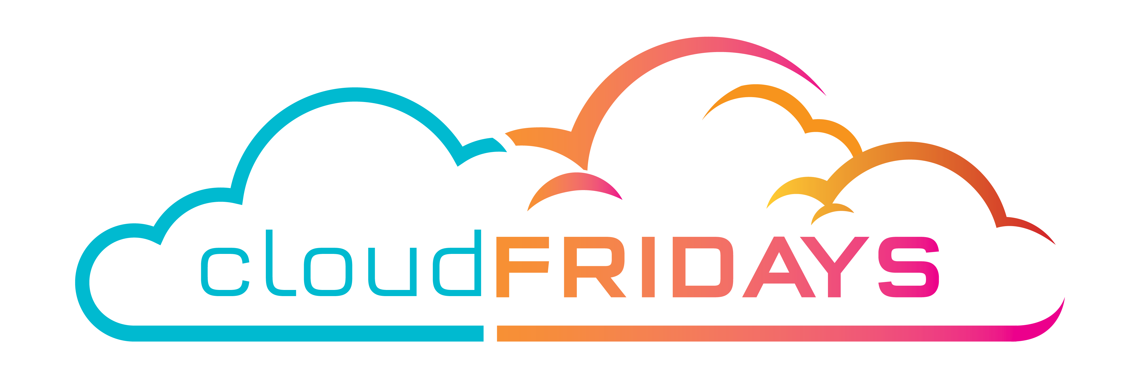
The Benefits and considerations of using cloud services
Nicolas Blank
Alistair Pugin

Slide 2

Agenda
Define : Cloud Computing, High Availability, Scalability, Elasticity, Agility, Fault Tolerance, and Disaster Recovery
understand the principles of economies of scale
Capital Expenditure (CapEx) vs Operational Expenditure (OpEx)
understand the consumption-based model

Slide 3
Define: Cloud computing
Cloud computing is the delivery of computing services—servers, storage, databases, networking, software, analytics, intelligence and more—over the internet (the cloud), enabling faster innovation, flexible resources, and economies of scale.
You typically pay only for cloud services you use, helping lower your operating costs, run your infrastructure more efficiently, and scale as your business needs change.

Slide 4
Define: High Availability
Redundancy of components within a system, which allows the system as a whole to suffer the failure of one ore more component pieces, WINTHIN a geography

Slide 5
Define: Disaster Recovery
Redundancy of components within a system, which allows the system as a whole to suffer the failure of one ore more component pieces, WINTHIN a geography

Slide 6
Define: XXX
XXX

Slide 7
Capex vs Opex

